Slide 1
Electron Configuration

Slide 2
Part 1: Our Analogy

Slide 3
Hotel Head to Toe
Our “hotel”, while fictional, is an analogy for electron configuration, or the arrangement of electrons in the orbitals of the electron cloud.
Guests = electrons
Floor = Energy level/ring/shell/orbital
Room type = Type of sub-orbital
Beds = Possible orientations of that sub-orbital
Head or toe = spin of the electron (spin up or spin down)
Steps = energy

Slide 4
S Orbitals
Orbitals are named by the types of spectral emission lines they leave.
“s” in s orbitals stands for “sharp” because they are very well-defined.
An s orbital is shaped like a sphere
Because of that, it has only 1 possible orientation because it looks the same regardless of how you view it.

Slide 5
P Orbitals
The “p” in “p orbitals” stands for “principle”.
A p orbital looks like a peanut and has three possible orientations, named px, py, and pz

Slide 6
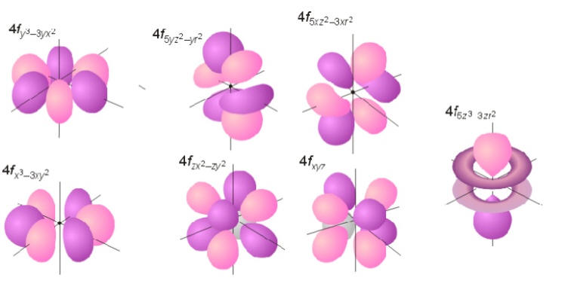
D and F Orbitals
“D” = diffuse
There are 5 types of D orbitals
“F” = fundamental
There are 7 types of F orbitals

Slide 7
Placing electrons
Electrons are placed according to the same three rules used in the Hotel Head to Toe worksheet:
The Aufbau Rule
Hund’s Rule
Pauli Exclusion Principle
Why do we care? Well the behavior of the atom is driven by this electron configuration. This includes how an atom will bond which is a BIG part of chemistry.

Slide 8
Aufbau Rule
States that electrons orbiting an atom fill the lowest available sub-orbital before moving to higher energy orbitals
“Aufbau” is German for “construction” or “building-up” and references the fact that we “build” the electron cloud from the ground (lowest energy) upwards.
Because of this the order of the sub-orbitals that we use is not always easy to remember (see below). Good news though is that there are a few easy tricks to remember the order.
Order: 1s, 2s, 2p, 3s, 3p, 4s, 3d, 4p, 5s, 4d, 5p, 6s, 4f, 5d, 6p, 7s, 5f, 6d, 7p
(There are theoretically more, but we do not have elements that exceed 7p yet! Once we do, it will theoretically go to 8s then to a new type of sub-orbital. I’m honestly super excited about when that happens, though I know that I am unique in that)

Slide 9
Trick #1 Filling Pyramid
Follow the arrows!
1s²
2s²
2p⁶
3s²
3p⁶
3d¹⁰
4s²
4p⁶
4d¹⁰
4f¹⁴
5s²
5p⁶
5d¹⁰
5f¹⁴
6s²
6p⁶
6d¹⁰
7s²
7p⁶

Slide 10
Trick #2- Madelung Rule
Also known as the Janet Rule, the Klechkowsky Rule, or the n + l rule
Calculate the n + l of the sub orbital.
n = which energy level (floor) is it on
l = the type of sub-orbital (l = 0 for s, 1 for p, 2 for d, 3 for f)
Sub-orbitals are filled from lowest n + l to highest.
4s: n = 4 , l = 0 so n + l = 4
3d: n = 3, l = 2 so n + l = 5
Thus 4s is filled before 3d

Slide 11
Trick #3 – Use the PT!
The PT is organized in the same way electrons are placed in the electron cloud. Just follow the pattern.

Slide 12
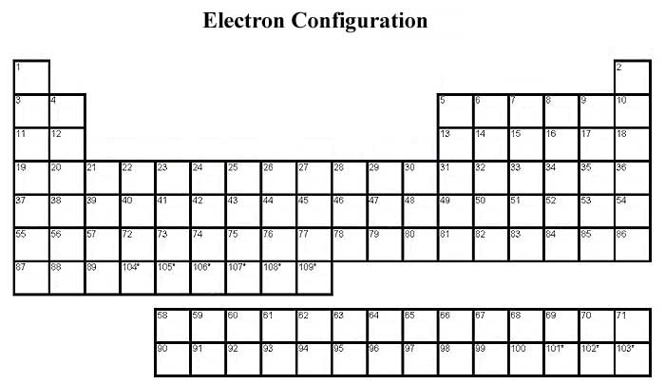
Helium is an exception….we’ll talk about why later.
1A
8A
1
2A
3A
4A
5A
6A
7A
2
3
s
p
3B
4B
5B
6B
7B
8B
8B
8B
1B
2B
4
3d
period # = # e- shells
d
5
4d
6
5d
7
6d
6
4f
f
7
5f

Slide 13
Hund’s Rule
Developed and named for Fredriech Hund
States that if there are sub-orbitals of equal energy (such as 2p’s 3 equal energy p sub-orbitals), then electrons will occupy them singly before doubling up.
Minimizes electron-electron repulsion and ensures the electrons are in lowest energy state. Lowest energy = most stable

Slide 14
Pauli Exclusion Principle
Developed and named for Wolfgang Pauli.
States that no two particles can have the same four quantum numbers (more of this in part three), meaning if two electrons are in the same sub-orbital, one has to be spin up and one has to be spin down.
Likely due to the fact that this allows for the magnetic moment generated by the different signs of their angular momentums to cancel and be lower energy.

Slide 15
How to Draw the Electron Configuration (also called the Orbital Diagram)
Determine the number of electrons present.
Remember, this is the same as the atomic # if the atom is neutral
If the atom is positive, subtract electrons (These come from the outermost energy level, not necessarily the last section)
If the atom is negative add electrons
Start at 1s. Draw 1 square or one dash
Put electrons in that square or on top of that dash(one up, one down).
Move to 2s.
Repeat until you have done all the electrons. Remember to fill in order and to spread out (Aufbau Rule and Hund’s Rule)

Slide 16
Part 2: Writing Electron Configuration

Slide 17
Orbital Diagrams vs. Electron Configuration
Drawing all those boxes and arrows gets tedious doesn’t it? Well chemists agree so instead we tend to NOT draw the boxes and arrows unless we really need to.
Instead we simply write the configuration of the element.
Drawing the boxes and arrows is called the “orbital diagram” of an atom.

Slide 18
Example #1 and #2
1. Neon: Has ten electrons
Electron configuration: 1s²2s²2p⁶
Where the “1s”, “2s”, and “2p” represent those specific orbitals and the superscripts represent how many electrons are in that orbital.
We could also write its electron arrangement as 2, 8 (2 electrons in first ring, 8 in second ring)
2. Aluminum: Has 13 electrons
Electron configuration: 1s²2s²2p⁶3s²3p¹
All the orbitals are filled except 3p which has only 1 electron.

Slide 19
Noble Gas Configuration
Even writing the electron configuration can be tedious for chemists (we really are a lazy group of people), so we have an even SHORTER way of writing the electron configuration called “Noble Gas Configuration”
We use the symbol for a noble gas to represent part of the configuration (the part that is the same as the configuration of that noble gas)
Why Noble Gases?
Chemists really only care about the valence electrons (outermost electrons)
Noble gases represent elements where the orbitals are all filled and stable and are no longer valence.

Slide 20
Example
Remember Neon’s and Aluminum’s electron configurations (below)
Ne: 1s²2s²2p⁶
Al: 1s²2s²2p⁶3s²3p¹
You can see that Aluminum’s configuration includes Neon’s configuration. We can replace that part of Aluminum’s configuration with the symbol “Ne” to represent that part and simply write what is left:
[Ne] 3s²3p¹
Note #1: We cannot use [Ne] to represent the electron configuration for Neon because it does not show the valence electrons. Instead, we would have to write [He] 2s² 2p⁶.
Note #2: Noble gases have their configurations end in __p⁶ where the ___ = their row #. The exception to this is He which still has a full shell but only has 1s².

Slide 21
Part 3: Quantum Numbers

Slide 22
Address of an electron
We can write the “address” of every individual electron in an atom because each electron has a set of four quantum numbers that uniquely describes it.
The four quantum numbers are:
n = principal quantum #
l = azimuthal quantum #
m_{l} = magnetic quantum #
m_{s} = spin quantum #

Slide 23
Principal quantum number
The principal quantum number indicates which energy level an electron is in.
Ex: an electron in 1s would have n = 1, while an electron in 2s would have n = 2 because 1s is located in the first energy level while 2s and 2p are located in the second energy level

Slide 24
Azimuthal quantum number
The term “azimuth” refers to an angle, thus the azimuthal quantum number is also called the angular momentum quantum number.
This number ranges from 0 to n-1 and indicates which type of suborbital an electron is located in. Each suborbital has its own number.
“s” has l = 0
“p” has l = 1
“d” has l = 2
“f” has l = 3……

Slide 25
Magnetic quantum number
The magnetic quantum number represents which orientation of a suborbital an electron is in.
The range of this number is from – l to + l.
Since “s” sub orbitals have only 1 orientation, m_{l} is always equal to 0 for electrons in them.
For an electron in a p, d, or f suborbital the convention is that the middle “bed” is labeled as m_{l} = 0, the one to the left is m_{l} = -1, the one to the right is m_{l} = +1 and so on so forth (for d and f)

Slide 26
Spin quantum number
The spin quantum number represents the spin of the electron.
Electrons have half-integer spin equal to ½ so this number will always be + ½ (if it is “spin up”) or – 1/2 (if it is “spin down”)

Slide 27
Example:
Q: Write the set of quantum numbers that describe the three electrons in lithium:
A:
electron #1: 1, 0, 0, + ½ (in 1s and is pointed up)
electron #2: 1, 0, 0, - ½ (in 1s and is pointed down)
electron #3: 2, 0, 0, + ½ (in 2s and is pointed up)

